Slide 1
Perceiving Internet Anomalies via CDN Replica Shifts
Tsinghua University
Northwestern University
Yihao Jia, Aleksandar Kuzmanovic
INFOCOM’19 Paris

Slide 2
network anomalies
CDN replica shift
Side A
Side B

Slide 3
The Challenge of internet anomalies perception
Timely
anomaly alert
Sophisticated measurement
internet anomalies detection involves measurements
real-time perception involves real-time measurements
real-time measurement is complicated
maintaining a real-time measurement system is costly

Slide 4
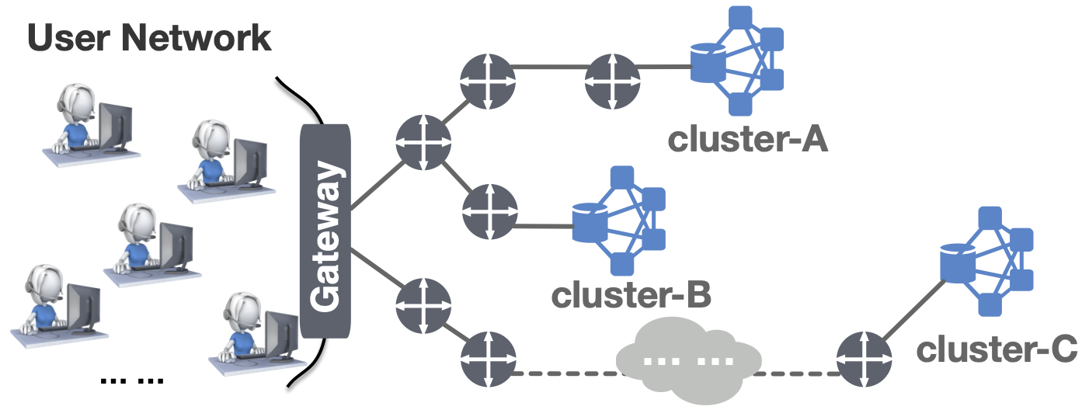
CDN replica assignments imply...

Slide 5
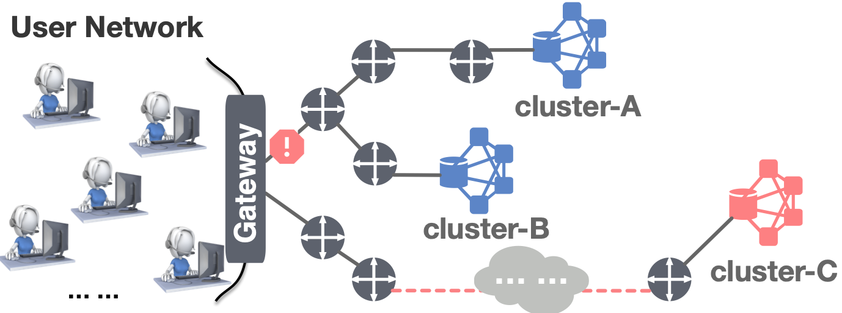
Why CDN replica assignments imply anomalies
CDN provides users with high QoS by extensive replicas
occasional network anomaly is a common event that degrade QoS
CDN re-assign replicas when anomalies hit the QoS

Slide 6
Replica assignment <> Anomalies
dodge
build
CDN
Anomalies
Network
QoS
network anomalies
Sophisticated
meaurement system
replica assignment

Slide 7
Detecting network anomalies
by observing CDN replica assignments
detect anomaly events in statistical terms
practically
as a “whistle-blower” to trigger sophisticated measurements

Slide 8
Content
Why replica shift…
How to observe the shift...
How replica shift...
Anomalies behind shifts…
Case study…
Conclusion...

Slide 9
How CDN control replica assignment (Background)
Anycast-based CDN
DNS-based CDN
user direction is naturally handled by the BGP
uncontrollable
self-controllable

Slide 10
How replica shifts imply anomalies?
INSIDER
OUTSIDER
internal
conventional
external
exceptional

Slide 11
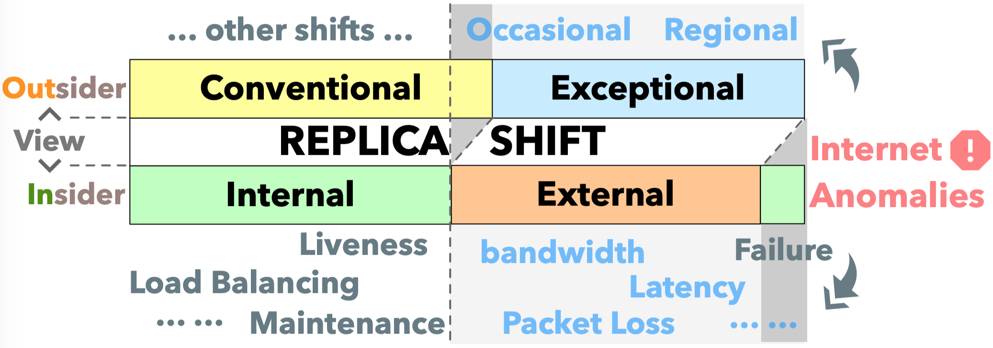
What drives a replica shift?

Slide 12
The exceptional shifts
Regional shifts
Occasional shifts
if the users are mapped to
a different region
than the one they reside in
Spatially exceptional
if the users are mapped to
an “alien” replica
that rarely, if ever, showed up for the particular users.
Temporally exceptional

Slide 13
Content
Why replica shift…
How to observe the shift...
How replica shift...
Anomalies behind shifts…
Case study…
Conclusion...

Slide 14
Discover the DNS behavior of CDNs
Focus on the DNS-based CDN
Explore it as an Outsider

Slide 15
The ECS option (Background)
What is ECS?
The ECS prevalence
Why ECS Valuable?
Elient Subnet Option: a DNS option that carry accurate user location
the prevalence of public DNS resolver
mapping accuracy (public resolver & Authoritative DNS)
DNS behavior can be remotely monitored from a single machine

Slide 16
How we measure
What CDN should we choose?
Which domain we select for each CDN?
using ECS option to carry IP of any networks
DNS-based, ECS enable
Domains that CONSTANTLY serve abundant trafﬁc

Slide 17
 | Domain | ECS enable? | How we measure?
Akamai | apple.com | No | 1000 U.S. public resolvers
Google Cloud | android.com | Yes | 1 Self-built resolvers (ECS-enable) [1000 public resolver IPs]
Fastly | imgur.com
Incapsula | t-mobile.com
Cloudfront | zillow.com

Slide 18
Content
Why replica shift…
How to observe the shift...
How replica shift...
Anomalies behind shifts…
Case study…
Conclusion...

Slide 19
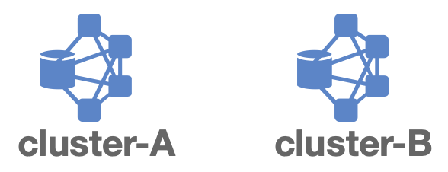
How to claim the shift...
replica assigned to
another cluster
replica’s IPs vary
beyond the /24 space
5.5.10.5
5.5.5.5
5.5.5.10
Shift
/24 is the longest preﬁx that can be routed by BGP
shifts within the same /24 reside in the same cluster, and share the same routes
Notes:
This, to a large extent, helps us to ﬁltering the shifts residing in the same cluster, which is probably not triggered by anomalies.

Slide 20
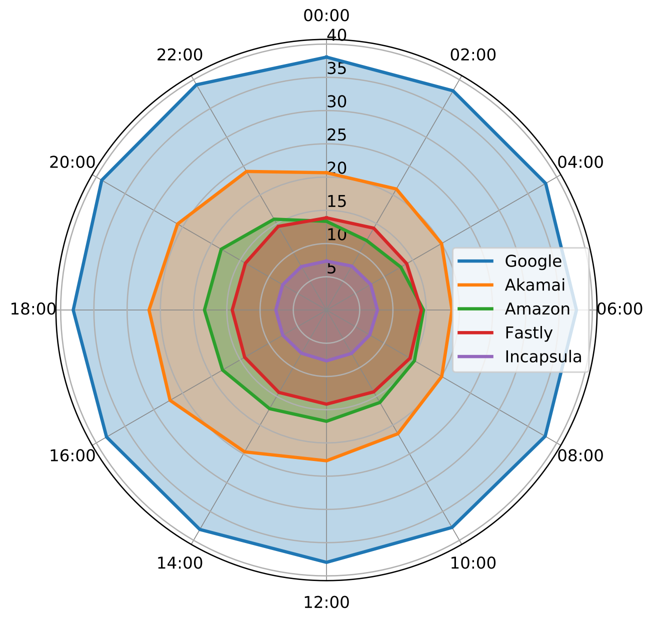
Replica shift frequency
Dampling rate: 20s
Data period: Jun. 2018
Frequency
Google>Akamai>Amazon>Fastly>Incapsula
Dynamism
Akamai & Amazon shift more frequently during daytime than overnight

Slide 21
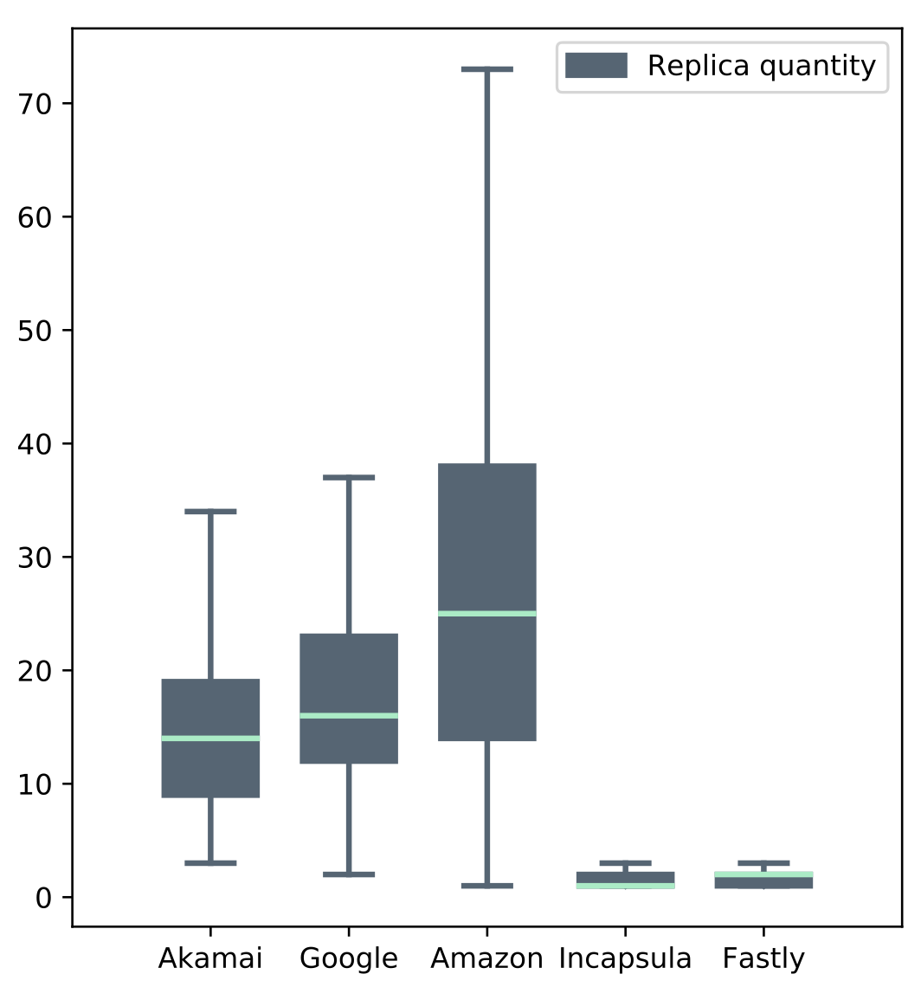
Regular replica quantity
across networks
Google, Akamai, Amazon show an afﬂuent quantity in assigning replicas to networks, far beyond that in Incapsula and Fastly

Slide 22
How to claim the exceptional shift...
For any kind of exceptional shift, we collect it’s
base replica
2. For a speciﬁc network, if a returned replica that outside the base, we call it the exception shift

Slide 23
How to claim the exceptional shift...
replicas that collected in U.S., Canada, Mexico
reginal shift
a new replica that outside the base
replicas that collected in June
Occasional shifts

Slide 24
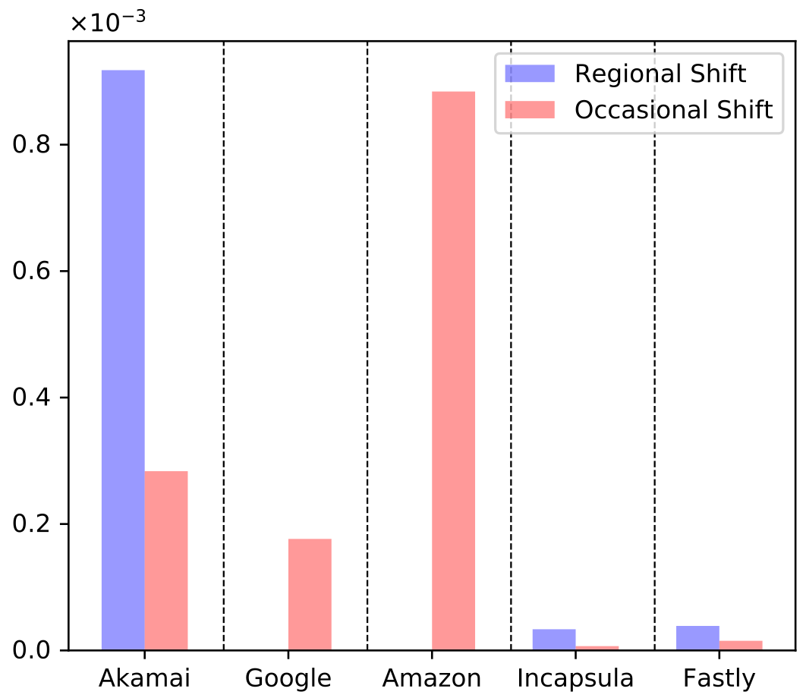
Frequency of occurrence: exceptional shifts
Evaluating phase: July 15 to 22, 2018
Both regional shifts and occasional shifts are rare among all CDNs
Google and Amazon show no regional shifts
Incapsula and Fastly rarely show regional and occasional shifts relative to others

Slide 25
Content
Why replica shift…
How to observe the shift...
How replica shift...
Anomalies behind shifts…
Case study…
Conclusion...

Slide 26
How to understand the anomalies?
Latency

Slide 27
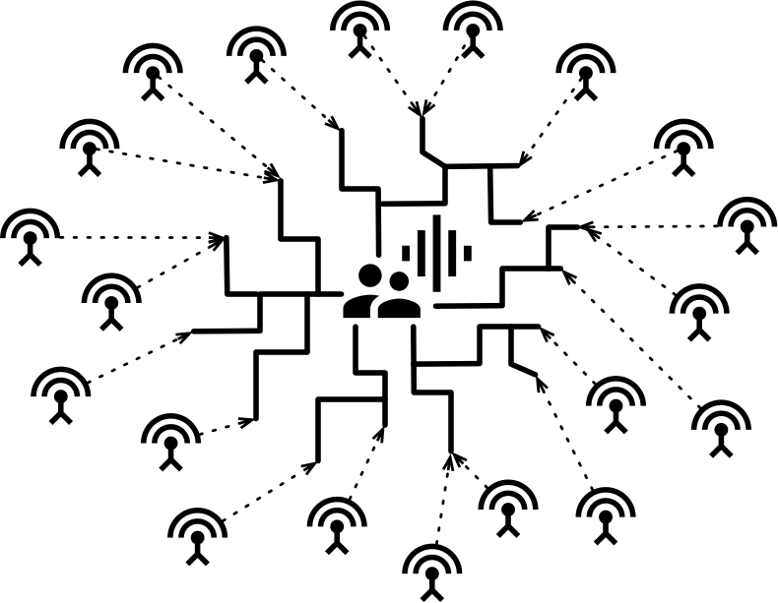
Probe
Network

Slide 28
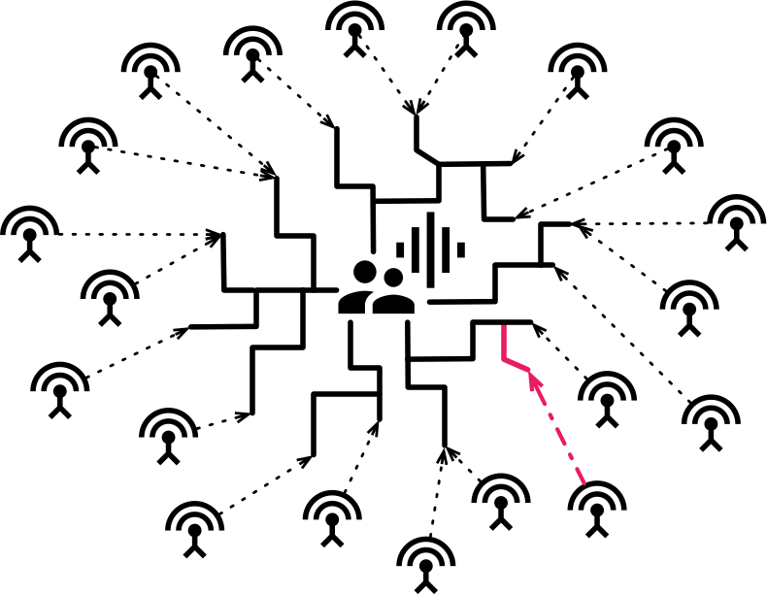
Probe
Network
exceptional shift
alert
probing
Find the maximal Δ

Slide 29
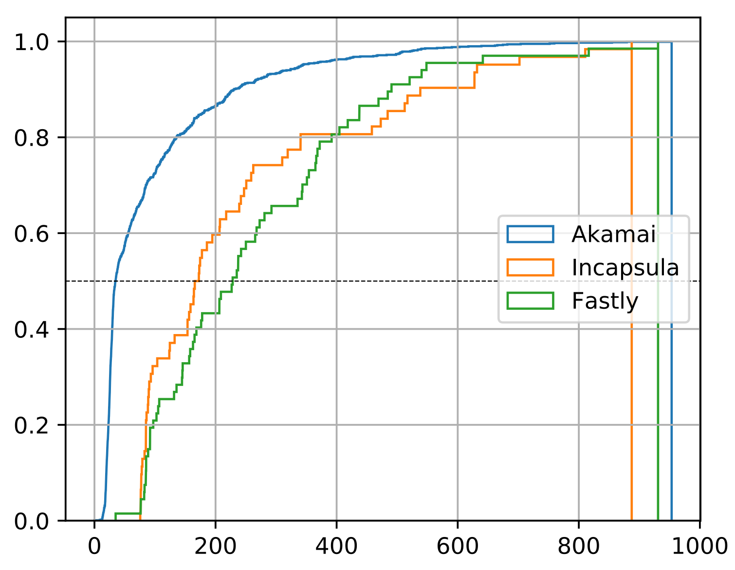
CDF of regional shifts on ∆value
Akamai:
Incapsula & Fastly:
Medain case
a weak indication for anomalies
a clear indication for anomalies

Slide 30
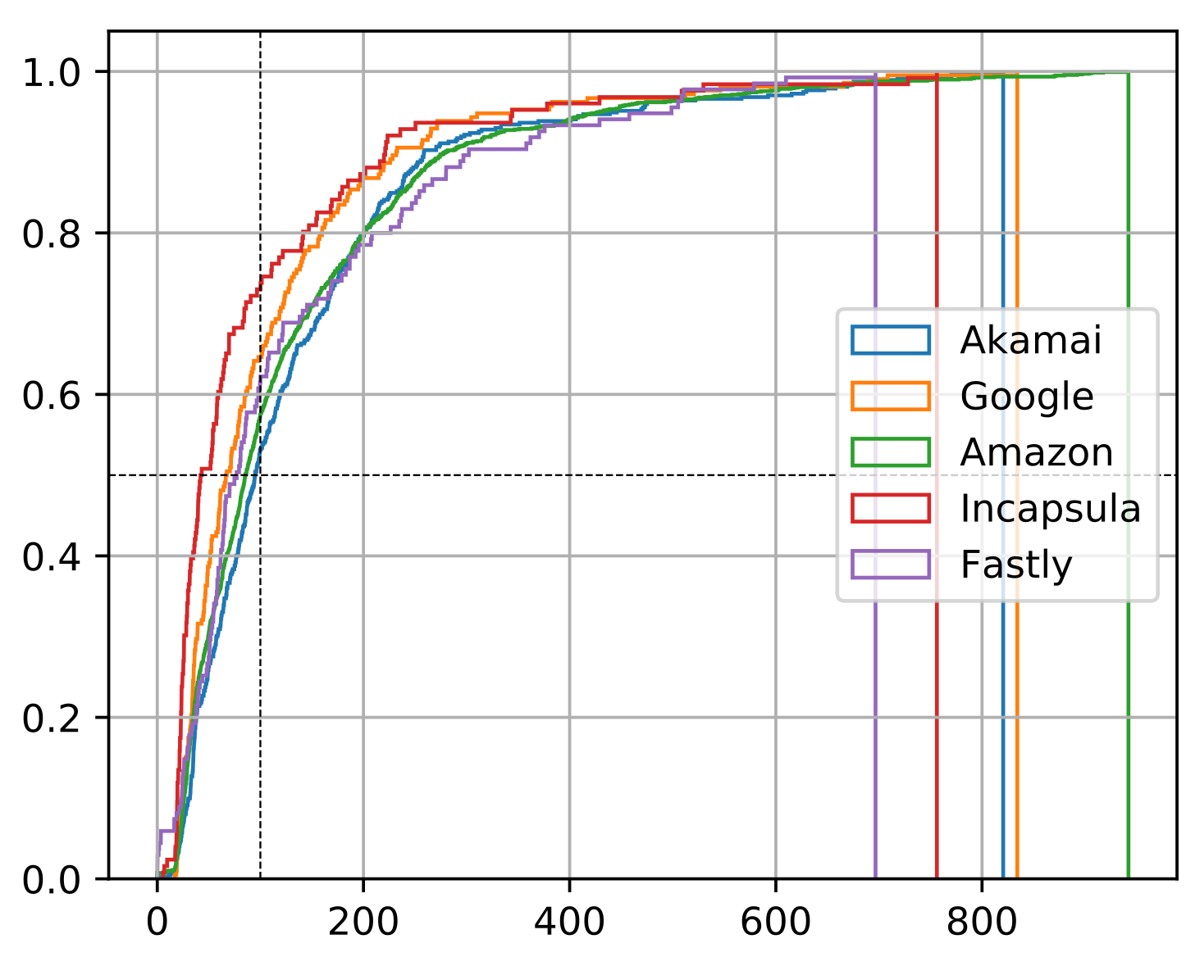
CDF of occasional shifts on ∆value
Medain case
All CDNs present a relatively weak indication

Slide 31
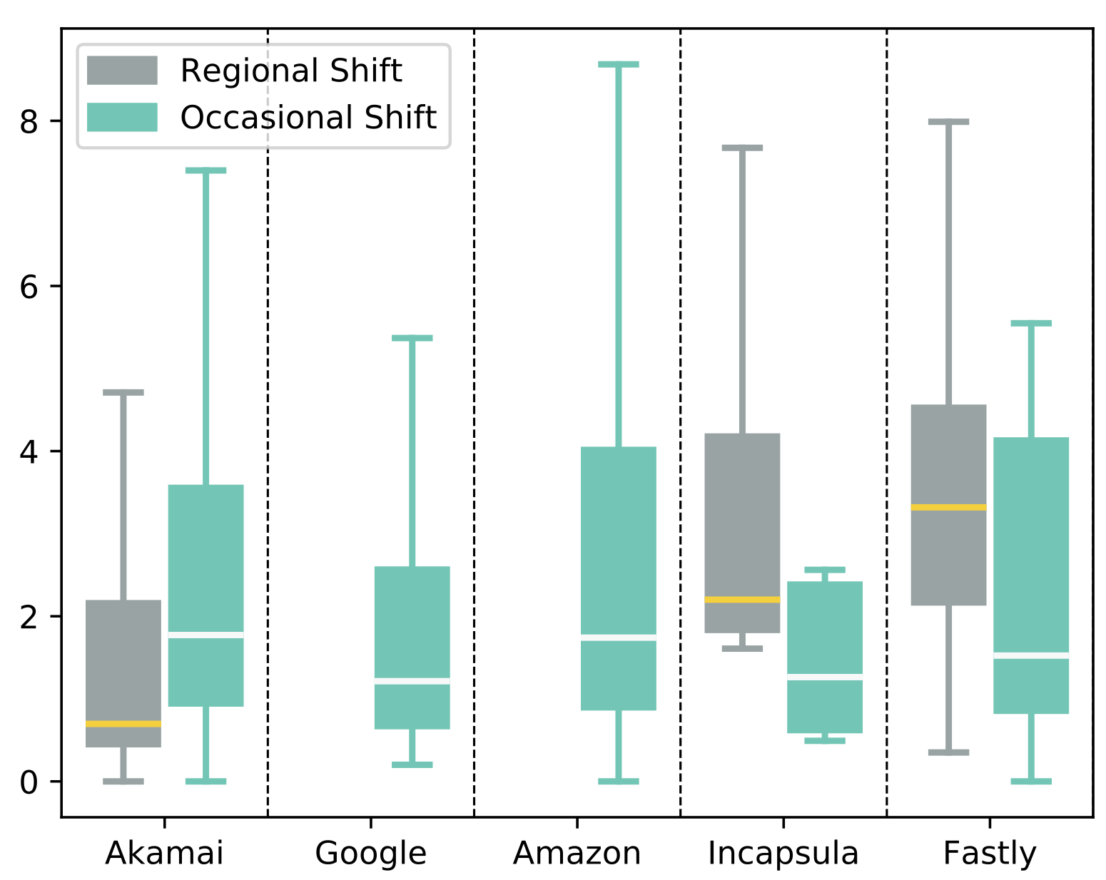
Distribution of ∆ratio (inflation)
Akamai:
Incapsula & Fastly:
a weak indication for anomalies on regional shift
a strong indication for anomalies on regional shift

Slide 32
Content
Why replica shift…
How to observe the shift...
How replica shift...
Anomalies behind shifts…
Case study…
Conclusion...

Slide 33
Exceptional shift
alert
alert
alert
Warning
alert
Detection via Multi-CDN
!
CDN-1
!
CDN-2
!
CDN-3

Slide 34
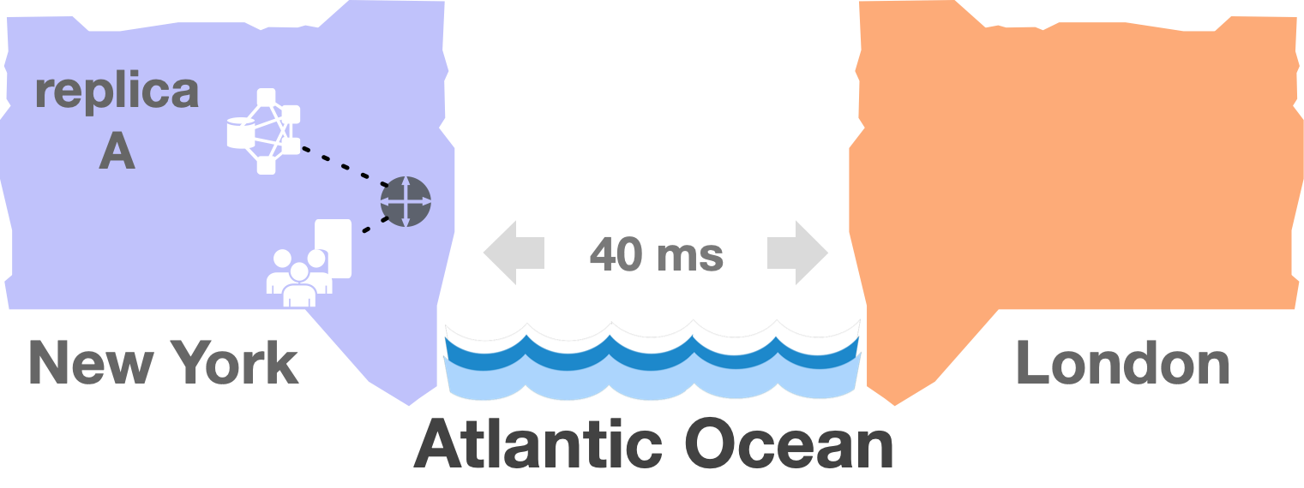
An anomaly case: routing detour
Content Service time:
0 ms

Slide 35
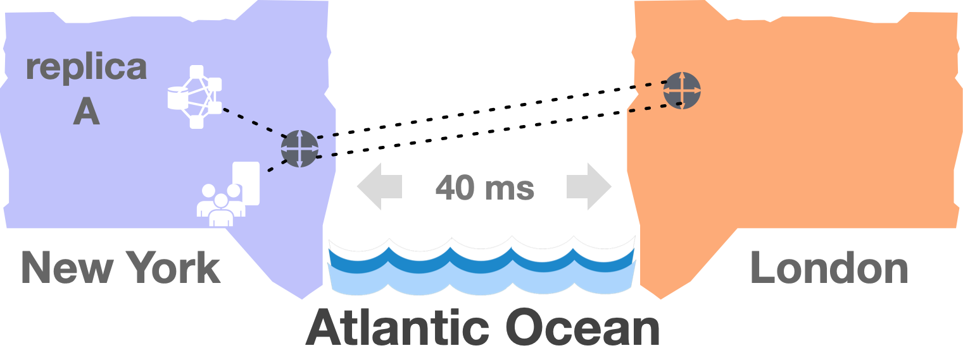
An anomaly case: routing detour
Content Service time:
80(40*2) ms

Slide 36
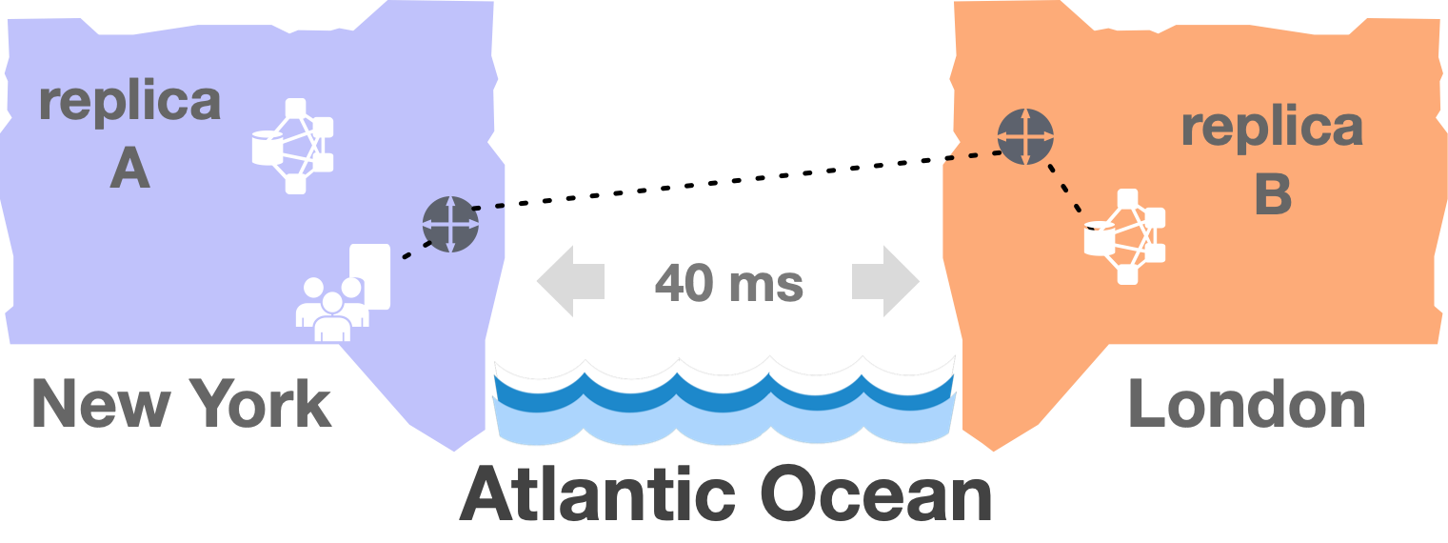
An anomaly case: routing detour
Content Service time:
40 ms

Slide 37
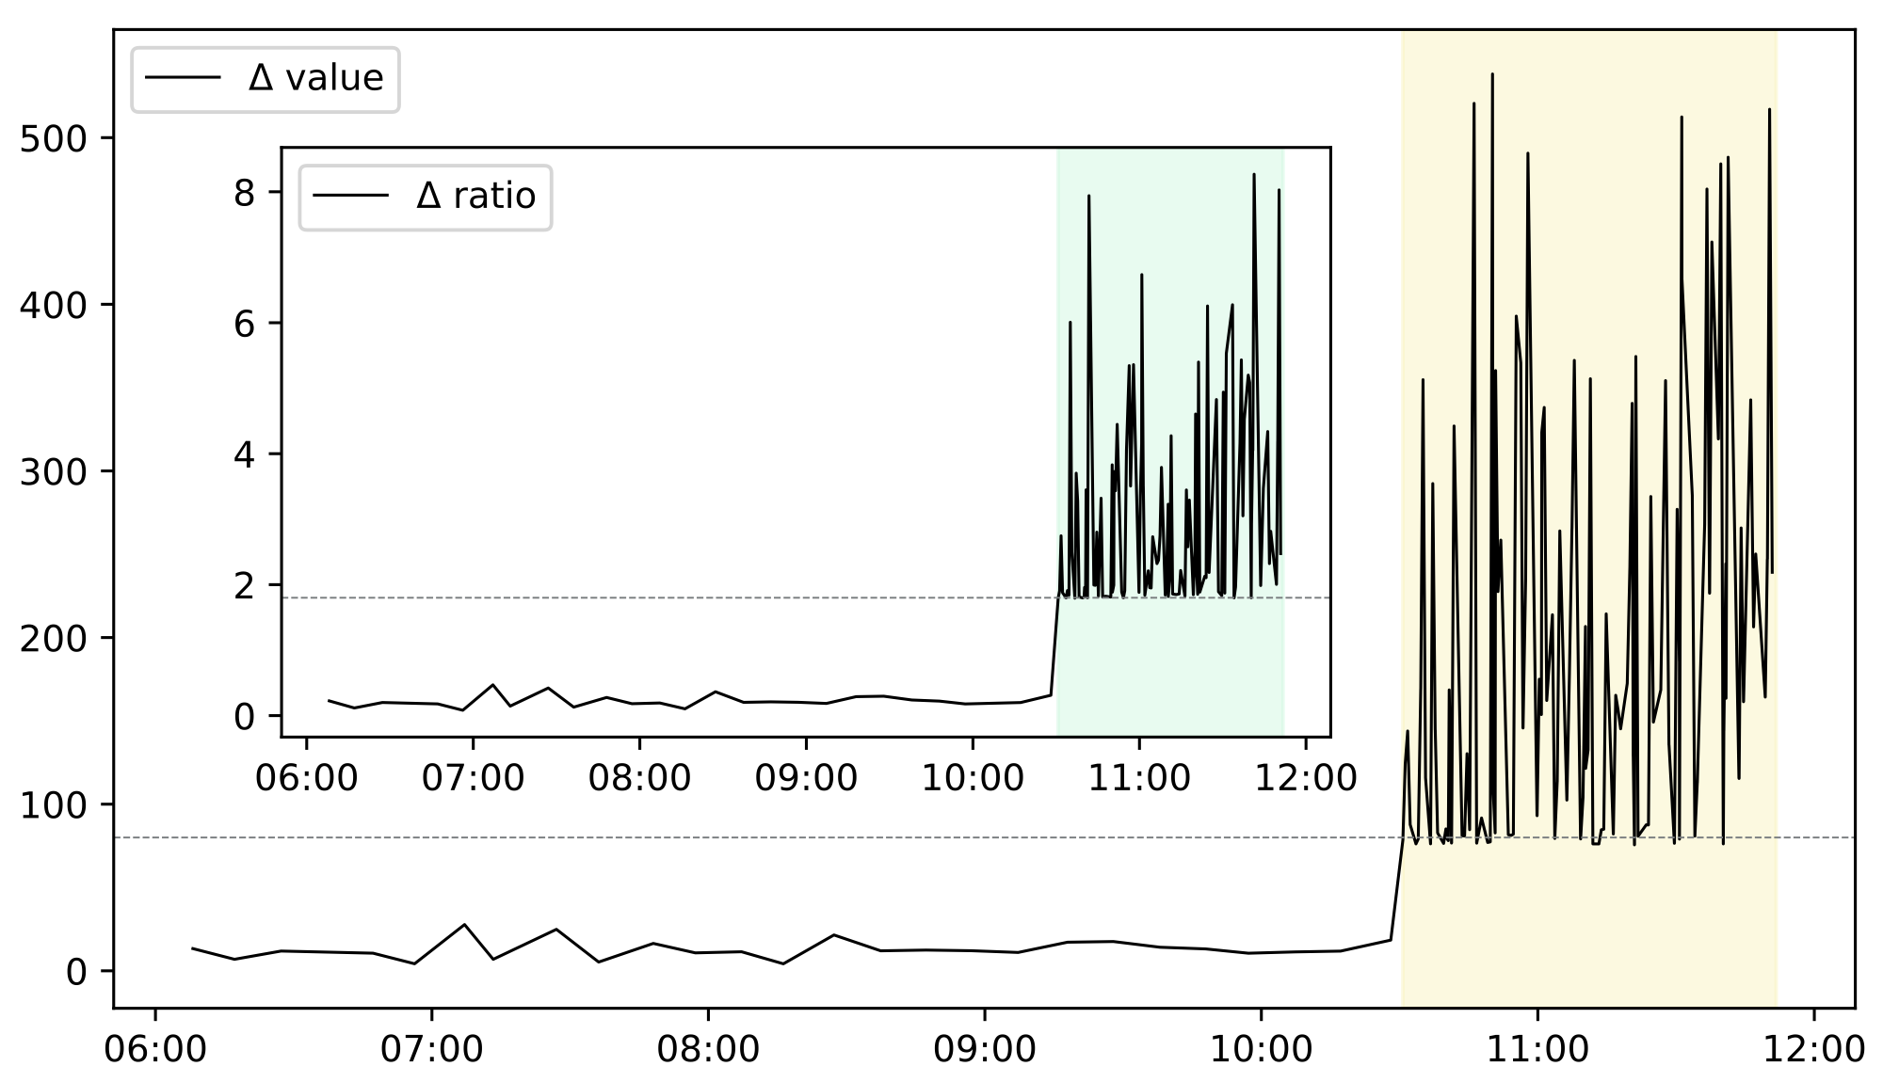
80(40*2) ms

Slide 38
Content
Why replica shift…
How to observe the shift...
How replica shift...
Anomalies behind shifts…
Case study…
Conclusion...

Slide 39
Insights
[Unexpectedly] Incapsula and Fastly are almost perfectly suited
lowest quantity of replica in their base
least number of replica shifts
smallest frequency of exceptional shifts
shifts strongly correlated with anomalies

Slide 40
Insights (Contd.)
Regional shifts are more correlated with anomalies than occasional shifts are.
[Counter-intuitively] replica shift by Akamai, Google, and Amazon are too sophisticated to be used to flag anomalies
Multiple CDNs concurrently exhibit an exceptional shift almost surely imply Internet anomalies.

Slide 41
SUMMARY
propose a methodology to perceive anomalies via CDN replica shifts.
Explore the factors and ingredients that contribute to the shifts and anomalies detection.
Study the accuracy and promptness of the most popular CDNs in anomaly resilience.
Validate the feasibility of the proposed methodology by predicting anomalies in an authentic network environment.
Notes:
This, to a large extent, helps us to ﬁltering the shifts residing in the same cluster, which is probably not triggered by anomalies.

Slide 42
Thank You!
Qustions & Comments
INFOCOM’19 Paris

Slide 43
Backup slides...
Q&A
Notes:
it is not very clear about what an Internet Anomaly actually is.
Is this methodology works in other country? - Europe?
CDN may shift differently among different domains.
What would anycast CDN do when anomalies happen?
if the proposed method fails to work on the biggest CDNs, the proposed approach may be limited.

Slide 44
Is methodology works in Europe?
For any kind of exceptional shift, we collect it’s
base replica
base replicas
exceptional shifts

Slide 45
May CDN shift differently among different domains?
Yes
Akamai design particular replica assignment model
for different business.
(static web content | streaming media | dynamic applications)

Slide 46
What would anycast CDN do when anomalies happen?
Anycast CDN wouldn’t be controlled by CDN,
but controlled by BGP itself.
Mixed CDN, i.e., Microsoft, might be especial.
(empowerd by both DNS and Anycast)
“Fastroute: A scalable load-aware anycast routing architecture for modern CDNs,” Microsoft, 2015.

