Slide 1
Mining Interesting Locations and Travel Sequences from GPS Trajectories
Yu Zheng, Lizhu Zhang, Xing Xie, Wei-Ying Ma
Microsoft Research Asia
Attack

Slide 2
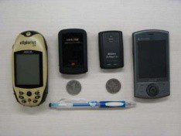
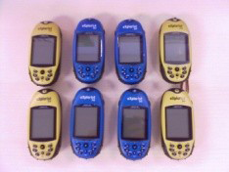
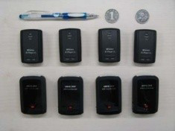
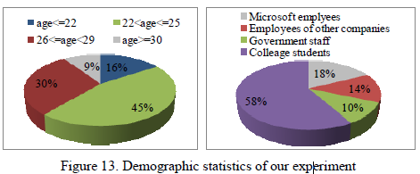

Slide 3
Overall score: 1. Definite reject.
Reviewer confidence: 4. High confidence
Technical merit: 2. Fair
Novelty: 1. Done before (not necessarily published)
Longevity: 1. Not important now, short lifetime

Slide 4
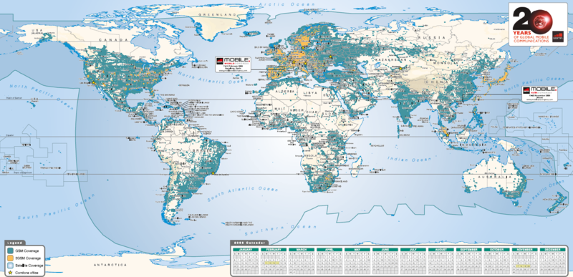
Wrong dataset
In this paper, based on multiple users’ GPS trajectories, we aim to mine interesting locations and classical travel sequences in a given geospatial region.
Enable GPS
Poor Signal
Expose privacy (payment)
GSM. base station : 0.2 km – 2km
Notes:
Accuracy: A big location

Slide 5
Small dataset
107 (49 females, 58 males) users → 29 users (Section 5.2.1)
The number of GPS points exceeded 5 million and its total distance was over 160,000 kilometers. –> 10,354 stay points → 7345 valuable stay points (table 1)
They trick you !

Slide 6
Untruth
Here, interesting locations mean the culturally important places, such as Tiananmen Square in Beijing, and frequented public areas, like shopping malls and restaurants, etc.
We evaluated our system using a large GPS dataset collected by 107 users over a period of one year in the real world.

Slide 7
Wrong motivation
Have Done
HelP
Hell
Such information can help users understand surrounding locations, and would enable travel recommendation.

Slide 8
Powerless citation and exaggeratory statement
Just In Abstract
a branch of Websites or forums [1][2][3], which enable people to establish some geo-related Web communities, have appeared on the Internet.
we aim to integrate social networking into the mobile tourist guide systems,
[2] http://www.gpsxchange.com/
www.google.com/latitude

Slide 9
No clustering
Further, users can obtain reference knowledge from others’ life experiences by sharing these GPS logs among each other.
No privacy, cluster users first, e.g. common interests. No clustering --- > No value…… at all

Slide 10
Efficiency 2.2
In short, the tree-based hierarchical graph can effectively model multiple users’ travel sequences on a variety of geospatial scales.
How efficient it is when your dataset faces the daily change issues?
The removal of the place.

Slide 11
Section 2.3
By changing the zoom level and/or moving this Web map, an individual can retrieve such results within any regions.
How many levels do you have? 4
Google 20

Slide 12
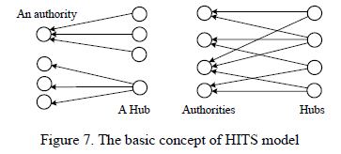
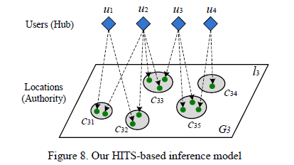
Nothing new in methodologies (1)
4.2.1. Borrow HITS (1999) to tie users and locations together
One-way vs. Two ways

Slide 13
Nothing new in methodologies (2)
4.2.2
Before conducting the HITS-based inference, we need to specify a geospatial region (a topic query) for the inference model and formulate a dataset that contains the locations falling in this region.
Borrow idea again!!!

Slide 14
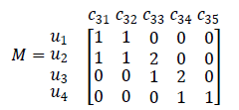
Nothing new in methodologies (3)
4.2.3.
1. In this matrix, an item 𝑣^{𝑖}_{𝑗𝑘} stands for the times that 𝑢_{𝑘} (a user) has visited to cluster 𝑐_{𝑖𝑗}(the jth cluster on the ith level).
2. “Power” iteration method.
Continue borrowing. Ur…..

Slide 15
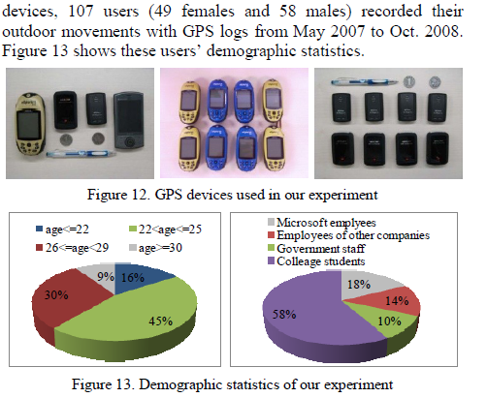
You have nothing to tell?
5.1.1
Do you use them later?

Slide 16
Unjustified thresholds
5.1.3
we set Tthreh to 20 minutes and Dthreh to 200 meters for stay point detection.
Randomly??
A shopping mall can not be larger than 200 * 200 square meters

Slide 17
Nothing new in methodologies (4)
1. We use a density-based clustering algorithm, OPTICS (Ordering Points To Identify the Clustering Structure), to hierarchically cluster stay-points into geospatial regions in a divisive manner.
  It is in ACM SIGMOD’99, Continue borrowing……
I. S. Dhillon. Co-clustering documents and words using bipartite spectral graph partitioning. In KDD ’01.
2. As compared to an agglomerative method like K-Means (1957),…
Come on…

Slide 18
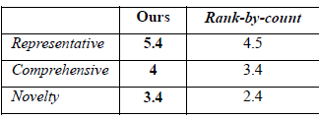
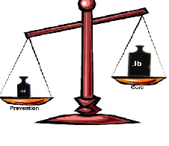
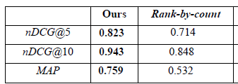
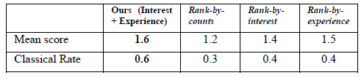
83.3%
87%
93.75%
Tradeoffs

Slide 19
Poor comparison
As a result, our HITS-based inference model outperformed baseline approaches like rank-by-count and rank-by-frequency.
Related works [1, 2] have studied mobility in the context of sequential rule mining, where the goal is to extract the most frequent trajectory sequences.
[1] . R. Agrawal and R. Srikant. Mining Sequential Patterns. In EDBT ’95.
[2] . F. Verhein and S. Chawla. Mining Spatio-Temporal Association Rules, Sources, Sinks, Stationary Regions and Thoroughfares in Object Mobility Databases. In DASFAA ’06.
1970
2001
2008

Slide 20
They are your most related works.
[1] . R. Agrawal and R. Srikant. Mining Sequential Patterns. In EDBT ’95.
[2] . F. Verhein and S. Chawla. Mining Spatio-Temporal Association Rules, Sources, Sinks, Stationary Regions and Thoroughfares in Object Mobility Databases. In DASFAA ’06.

Slide 21
Back to defense

