Slide 1
Are You Moved by Your Social Network Application?
Gregory Peaker

Slide 2
Overview
This Research Paper is very well written
Good introduction in the Title
Outline:
  Introduction
  Reasons for work and related work
  Properties of Nodes
  Conclusions
Relevant Today

Slide 3
Introduction
Compare social graph containing friends vs. contact graph that is temporal network created by opportunistic contact
  Prove most properties of nodes, links, and paths correlate among social and contact graphs
  Describe how structure of social graph helps build forwarding paths in contact graph, allow two nodes communicate over time using opportunistic contact and intermediate nodes

Slide 4
Introduction
Study relation between social interactions and physical meetings – remains largely unexplored
  28 participants in ACM CoNEXT 2007
  Ask each participant to friend others in list of attendees
  Ignore or add friend when within Bluetooth distance
  Conference is reasonable group size and can be reproduced
Applied to delay tolerant network

Slide 5
Related Work
Properties of paths built in quickly varying graph is new topic
  Opportunistic forwarding should be aware of social properties
  Compare initial social network vs. opportunistic contacts
  9024 opportunistic contacts made

Slide 6
Results
Properties of paths built in quickly varying graph is new topic
  Opportunistic forwarding should be aware of social properties
  Compare initial social network vs. opportunistic contacts
  9024 opportunistic contacts made

Slide 7
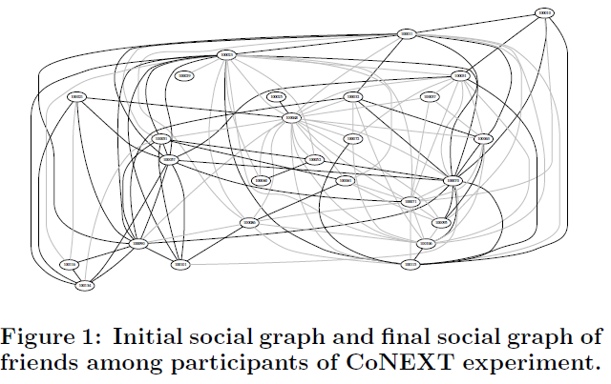
Results Figure 1

Slide 8
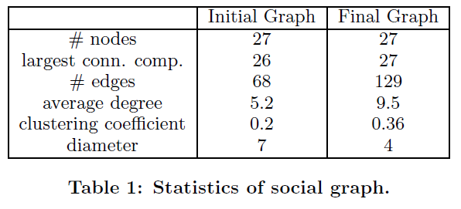
Results Table 1

Slide 9
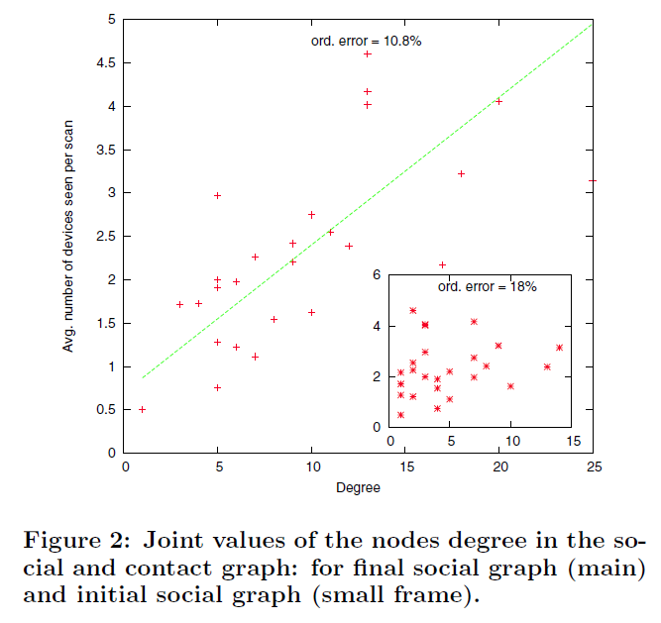
Results Figure 2

Slide 10
Results
The median inter-contact time grows from 6 minutes between two friends, to nearly an hour (ten time more) when nodes have distance three or four ins social graph
75% of contacts with friends are longer than 10 minutes. Where 75% of contact with nodes distance four are shorter than 13 minutes.

Slide 11
Applications and Future Work
Tested rules for sending packets
neighbor(k): (u → v) is allowed if and only if u and v are within distance k in the social graph.
destination-neighbor(k): (u → v) is allowed if and only if v is within distance k of d.
non-decreasing-centrality: (u → v) is allowed if and only if C(u) ≤ C(v).
non-increasing-distance: (u → v) is allowed if and only if the social distance from v to d is no more than the one from u to d.

Slide 12
Applications and Future Work
Neighbor rule performs as well as most other rules. Performs significantly better than random choice.
Rule based on centrality outperforms all rules tested (reaching more than 95% of success with half the pairs)
The combination of neighbor and centrality rules naturally improves selectivity, offering more flexibility and achieve some best trade-offs

Slide 13
Applications and Future Work
Without infrastructure, must exchange information an social network allows this
Future work wish approximate centrality of a node in distributed algorithm
Centrality creates issue with targeting same set of nodes, fix this

